Slide 1
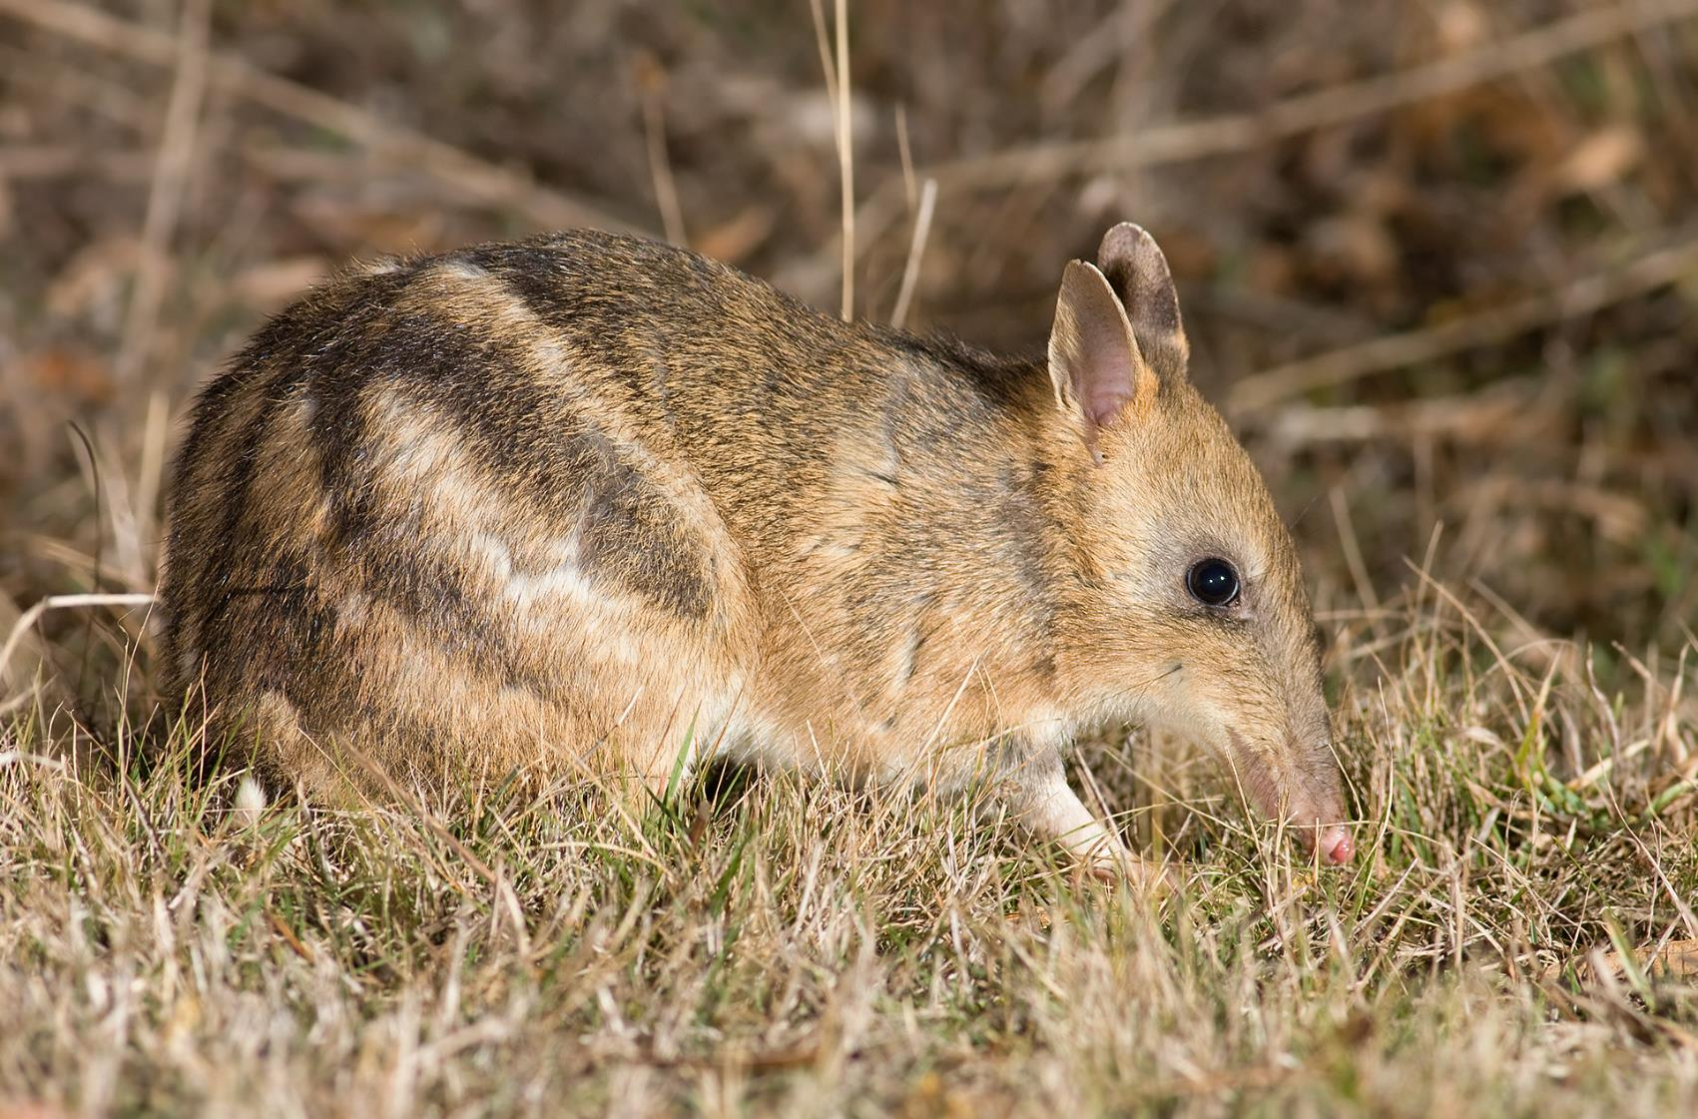
What’s missing and why does it matter?: Restoring ecosystems by bringing back the diggers
Euan Ritchie, Deakin University
www.euanritchie.org

Slide 2
“There was a plague of them and one night I got approximately 300 which had been poisoned in the garden during night. This went on for two or three years”
“completely distracted by the numbers of wallabies, paddymelons and kangaroo rats that bounded off on all sides”
“full of Wallabi holes”

Slide 3
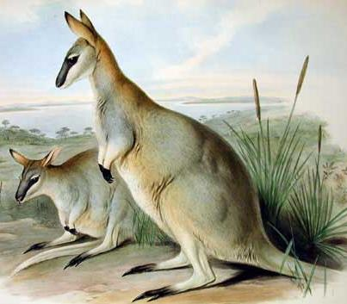
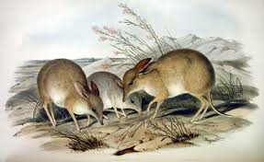
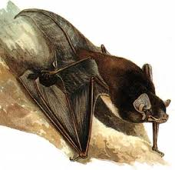
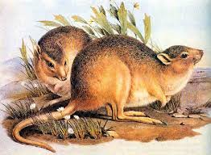
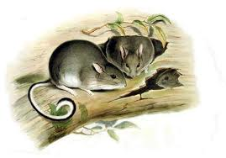

Slide 4
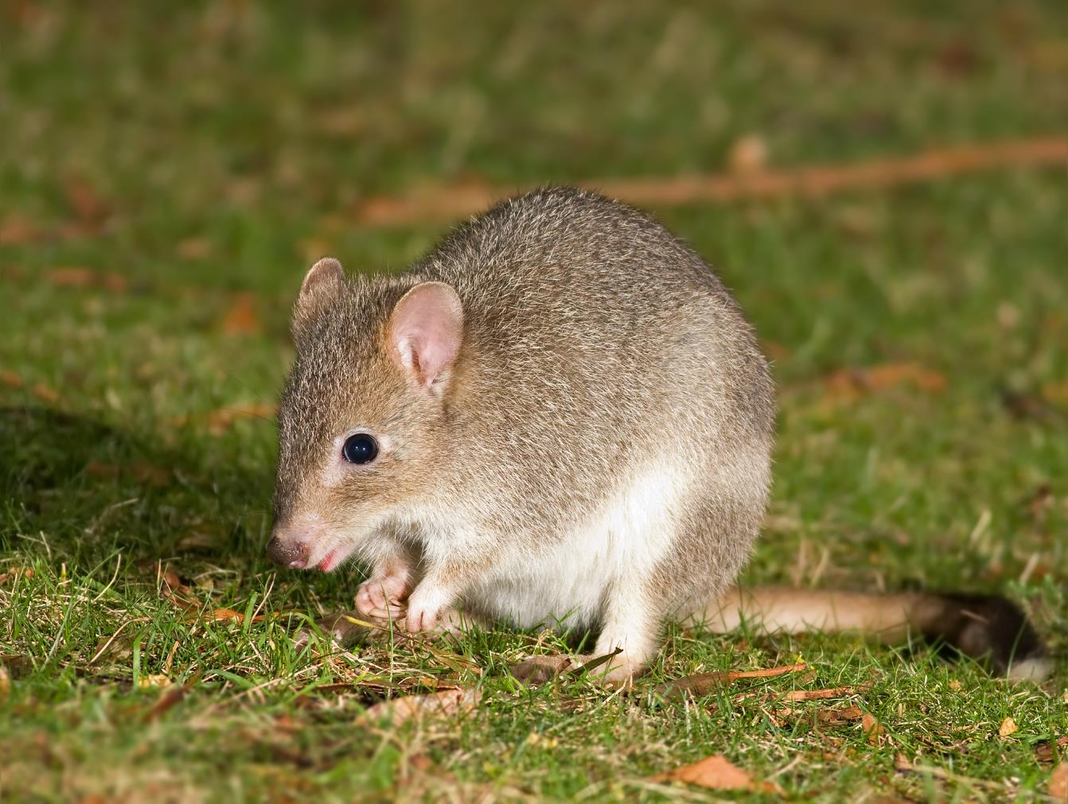

Slide 5
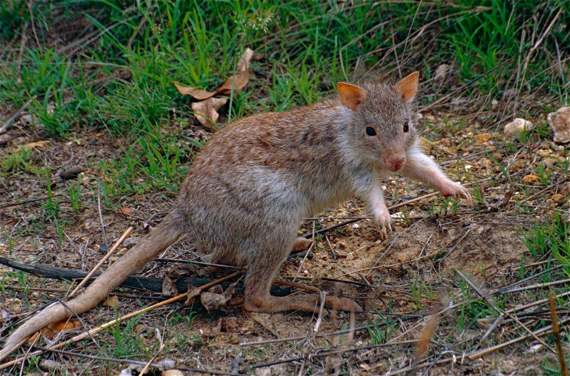

Slide 6
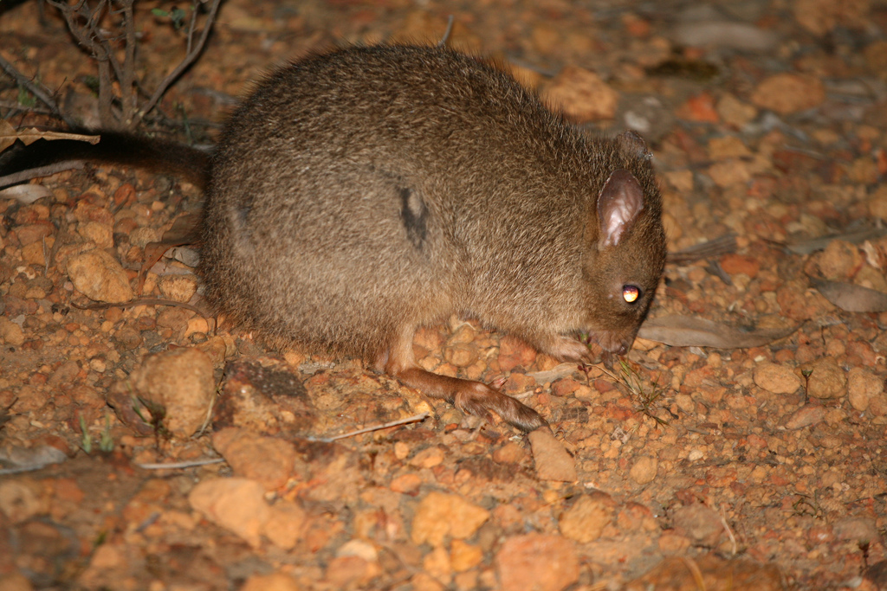

Slide 7
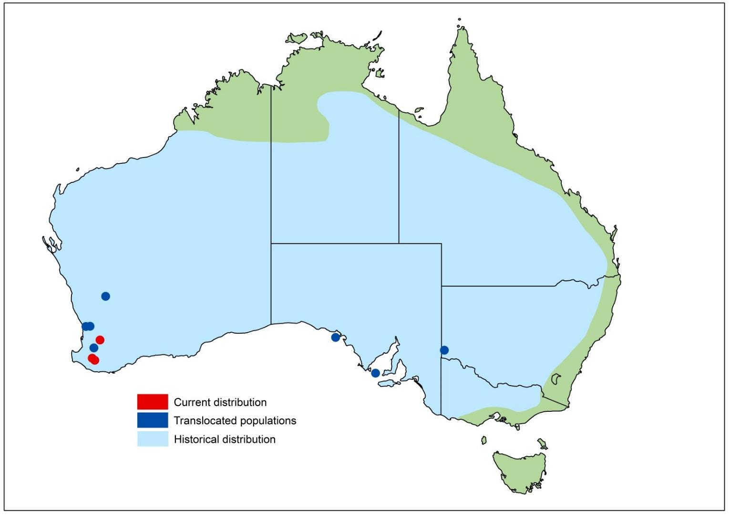

Slide 8
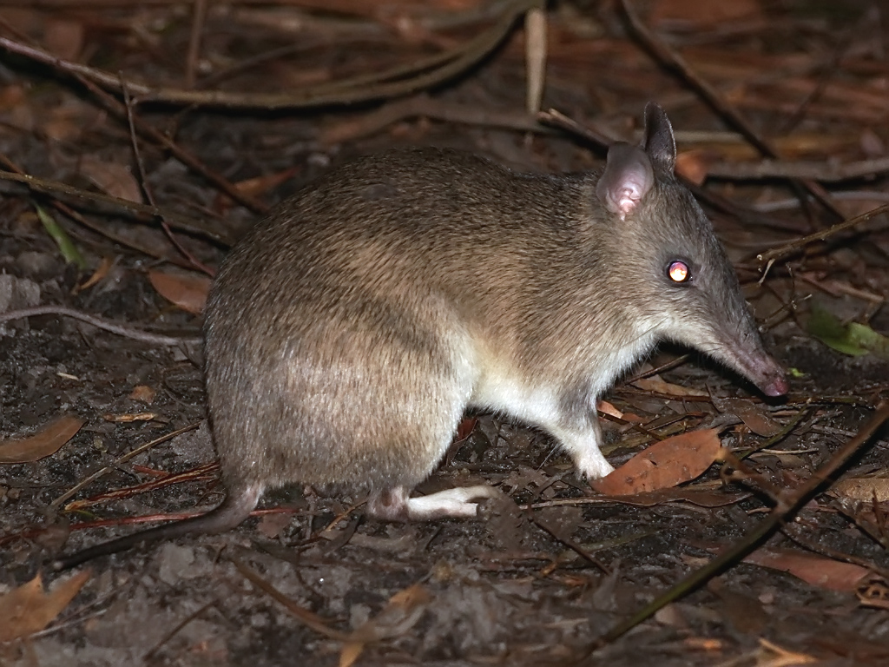

Slide 9
Worst record of mammal extinctions

Slide 10
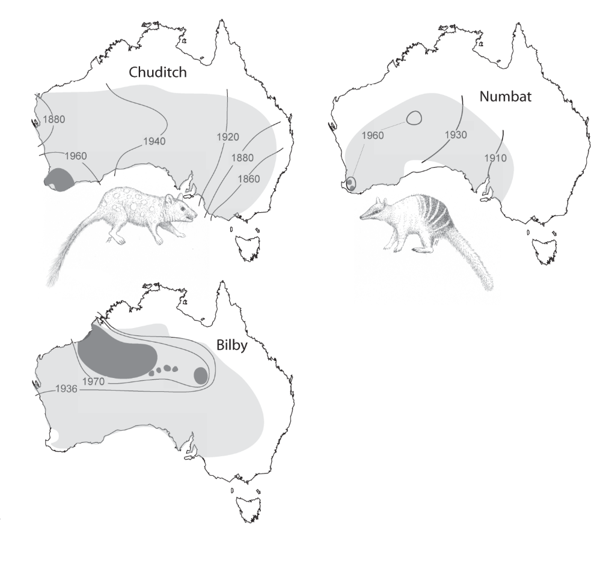
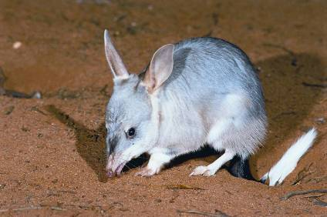
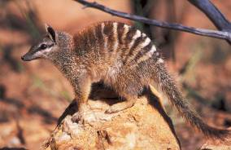
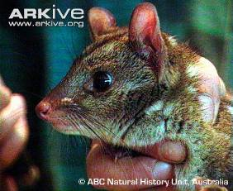
Many species extinct, many on the brink
>10% of 273 Oz land mammals extinct since European arrival
>20% of remaining mammals are threatened

Slide 11
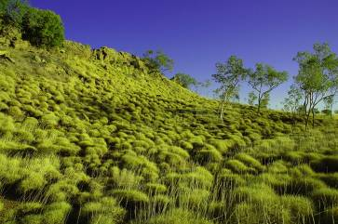
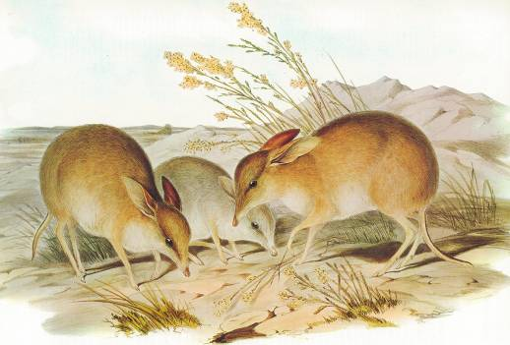
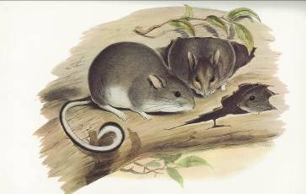
Patterns of recent extinctions
Medium-sized ‘critical weight range’ (> 35 g - < 5.5 kg)
Ground-dwelling species
Open and arid habitats

Slide 12
“What escapes the eye…is a much more insidious kind of extinction: the extinction of ecological interactions”
Daniel Janzen

Slide 13
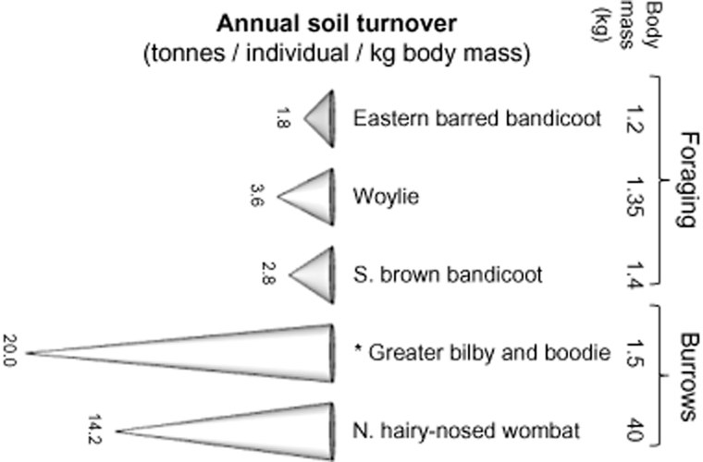
How good are Australia’s digging mammals?
Fleming et al. (2013) Mammal Review

Slide 14
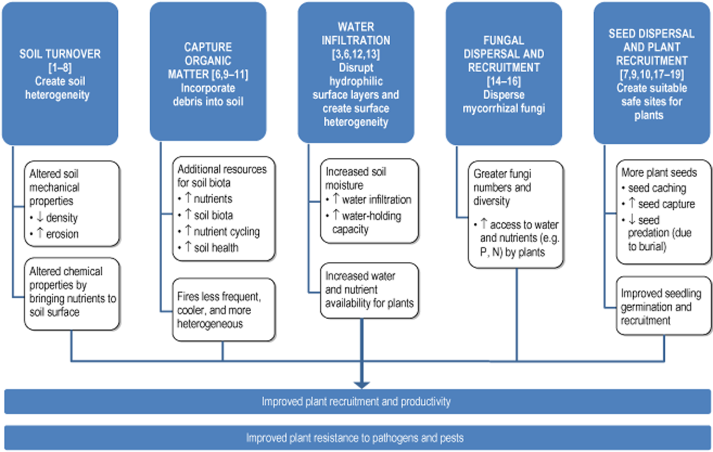
Fleming et al. (2013) Mammal Review

Slide 15
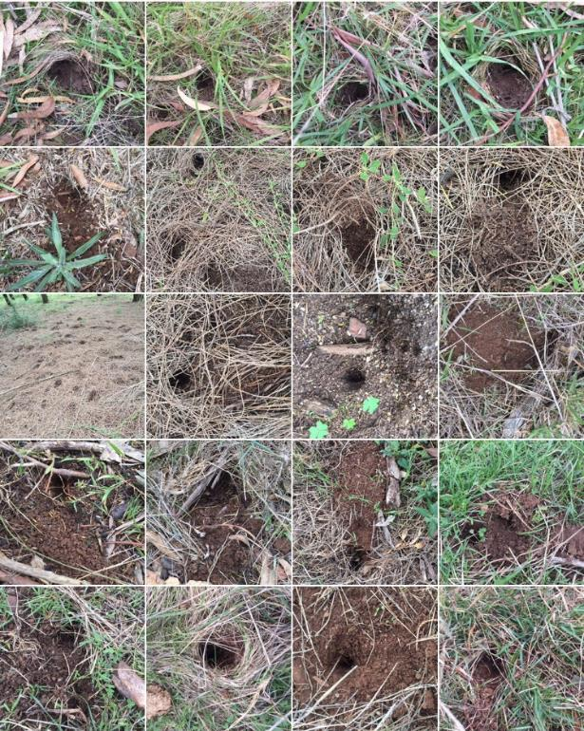
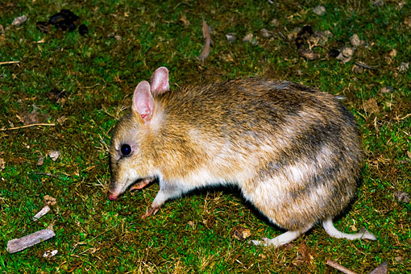
Eastern barred bandicoot digging (Churchill Is.) – Halstead et al. unpublished data
487 new foraging pits per bandicoot (24 hours / ha)
4.8 (4.1-5.2) tonnes annually
AUSBlick

Slide 16
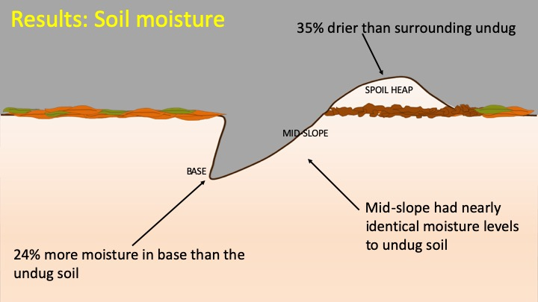

Slide 17
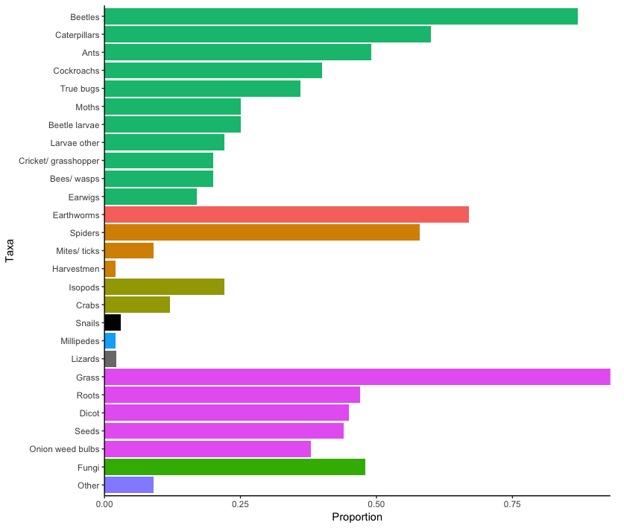
Eastern barred bandicoot diet (Churchill Is.) – Lloeffler et al. unpublished
Insecta
Annelida
Arachnida
Crustacea
Mollusca
Myriapoda
Reptilia
Plant
Fungi
Notes:
Omnivorous - Invertebrate, plant & fungi material
Most common taxa:
Plant (98%)
Beetle adults (87%)
Earthworms (67%)
Caterpillars (60%)
Spiders (58%)
Ants(49%)
Fungi (48%)
Also of note:
Crabs (12%) - first study to report, suggests can exploit new resources
Lizard scales (2%)
Snails (2%)
Also looked at beetle diversity but don’t have time to discuss here, but will be in my thesis

Slide 18
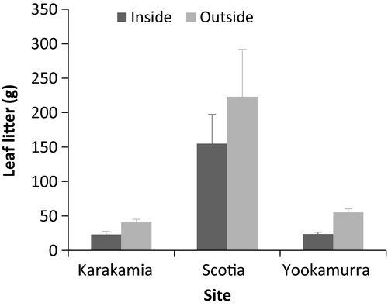
Fire risk?
Flame height at Scotia predicted to reach
1.41 m outside the fences compared to 0.37 m inside the fences
Fire predicted to spread faster outside the fences (0.18 km hr) compared to (0.12 km hr) inside the fences
= ~ 74% reduction in flame height and a 33% reduction in the rate of fire spread
Hayward et al. (2016) Animal Conservation

Slide 19
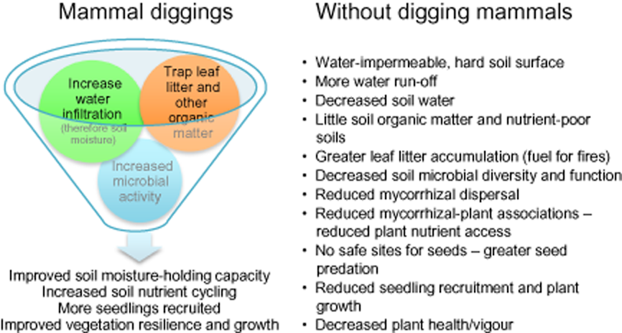
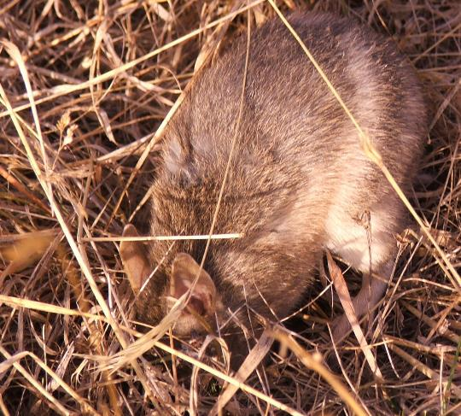
Amy Coetsee
Fleming et al. (2013) Mammal Review

Slide 20
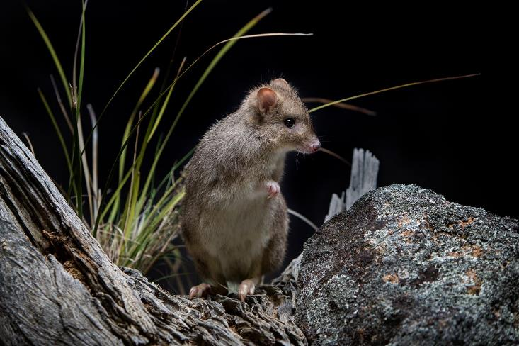
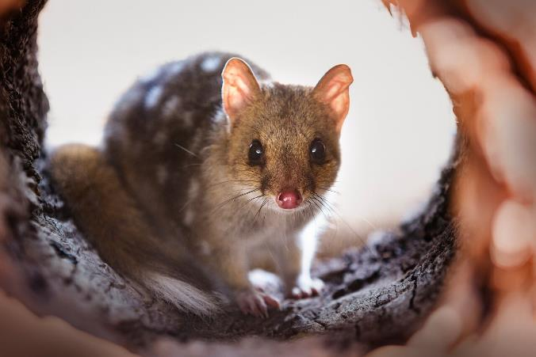
Restoration programs
Source: MulligansFlat
Notable and inspiring success stories (e.g. Mulligans Flat, Flinders Ranges, Booderee)
Why not in central Victoria?

Slide 21
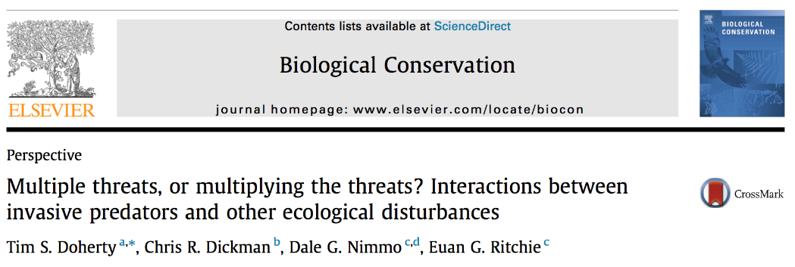
Ecology isn’t rocket science…it’s harder
For every complicated problem, there’s an easy solution…that’s probably wrong
Ignore complexity at your peril
Ecological restoration often focuses on achieving a single goal (e.g. control of a pest species, revegetation)

Slide 22
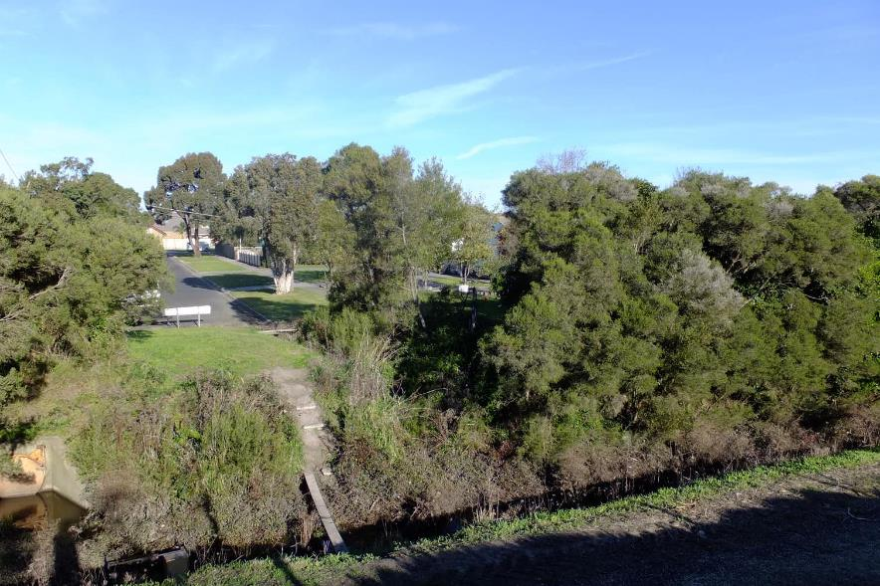
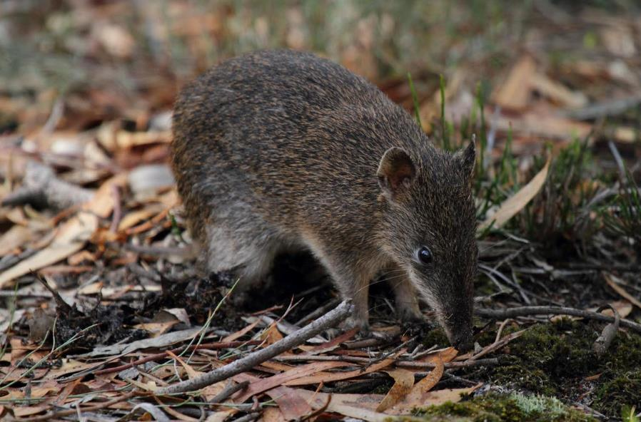
What’s needed for restoration to work?
Open minds

Slide 23
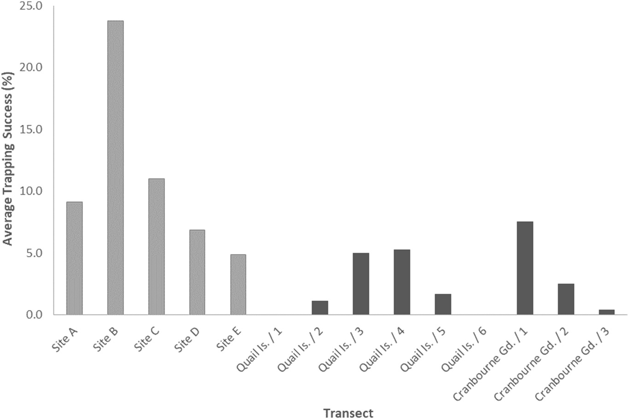

Slide 24
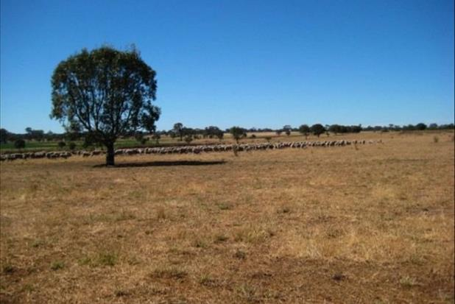
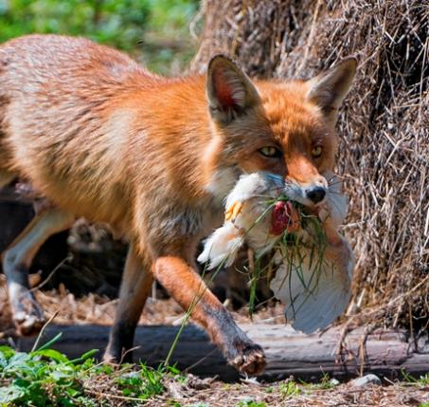
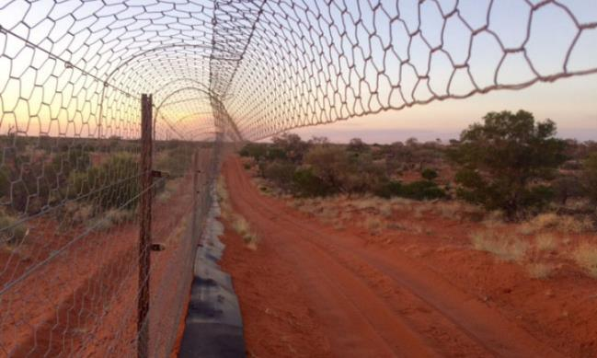
What’s needed for restoration to work?
Traditional considerations and tools

Slide 25
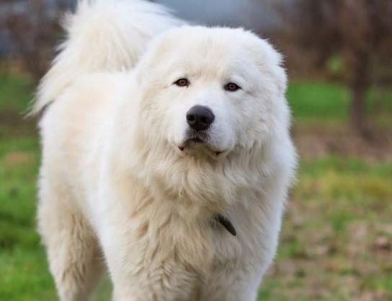
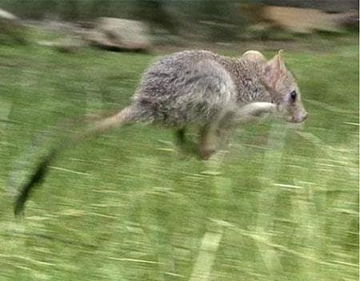
What’s needed for restoration to work?
New tools

Slide 26
